Slide 1

ENERGETIC SIMULATION OF A BUILDING IN DIFFERENT LOCATIONS
TECHNICAL ENVIRONMENTAL SYSTEMS
JAN | 2018
JOANNA ABBAS JOSE DAVID HERAS
REEM BOU HAMDAN ALDO VINCIGUERRA

Slide 2
INTRODUCTION
Computer Modelling and Simulation of how a building performs in terms of energy consumption is extremely important for designers, users and especially developers. The key reason is to understand the building condition and run an analysis against utility bills with the aim of reducing the energy consumption of the buildings and achieve a more sustainable and efficient design.
There’re many software available, in this case a computer modeled and simulated building was performed in Sketchup, OpenStudio and Energy Plus. Energy Plus provides an integrated simulation for accurate temperature and comfort prediction. The simulation was performed in several locations during the whole year in order to compare the different values between diverse climates. It has a special focus in the city of Oslo, Norway, where bad, normal and good insulation characteristics were included to find the most efficient choice.
The offices modeled building is three stories high and has a standard construction with concrete agregate exterior walls that vary in insulation properties, drywall interior walls and exterior shading with the exception of the north facade are included in the model. The input data were building constructional records, local climate data, occupancy, internal load, HVAC and lighting component data, equipment data etc. Different thermal zones were taken into consideration in order to achieve a more accurate analysis.

Slide 3
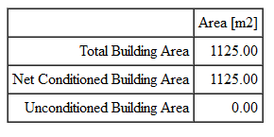
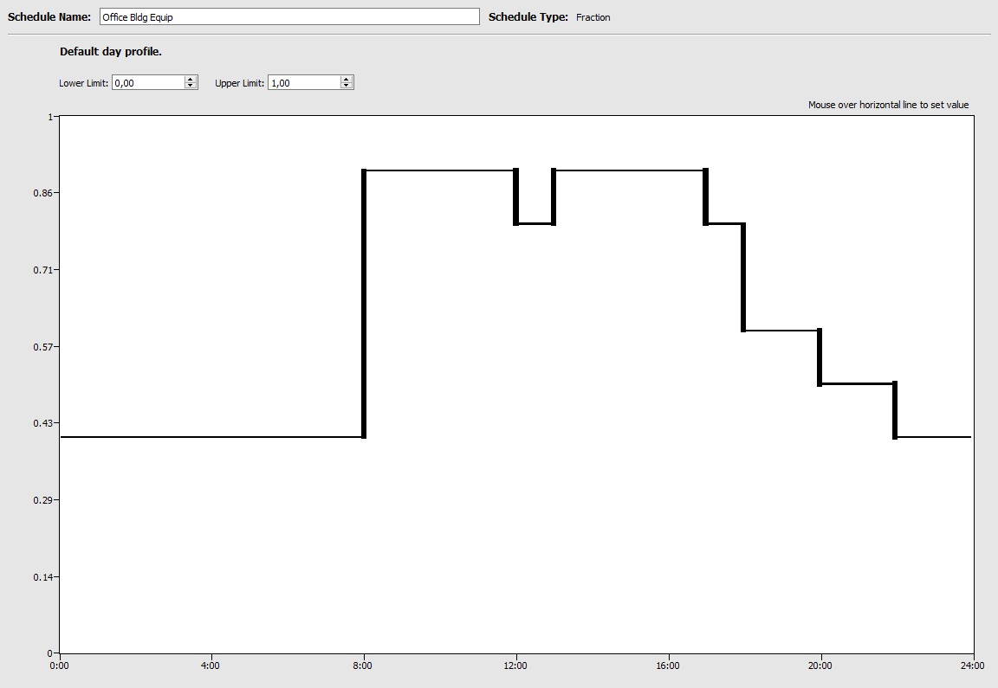
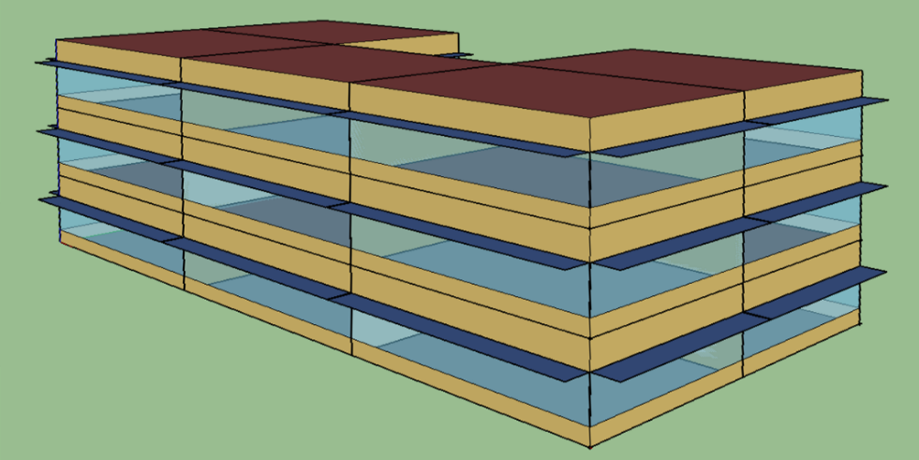
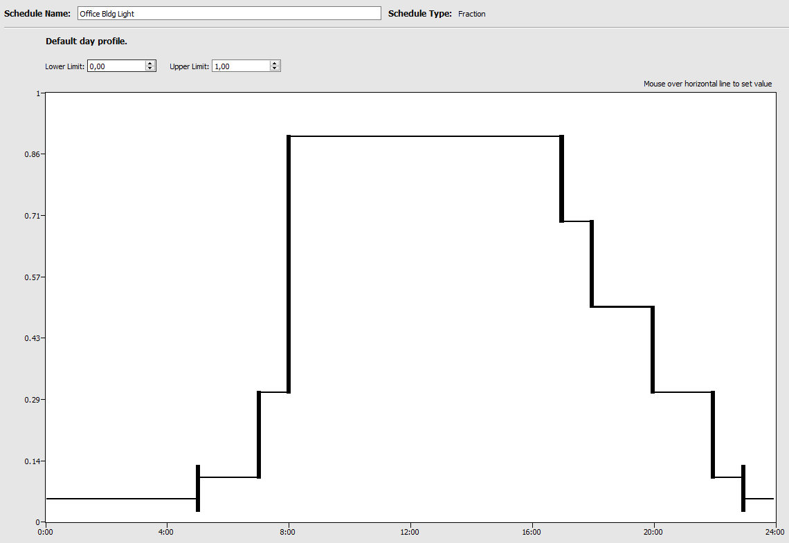
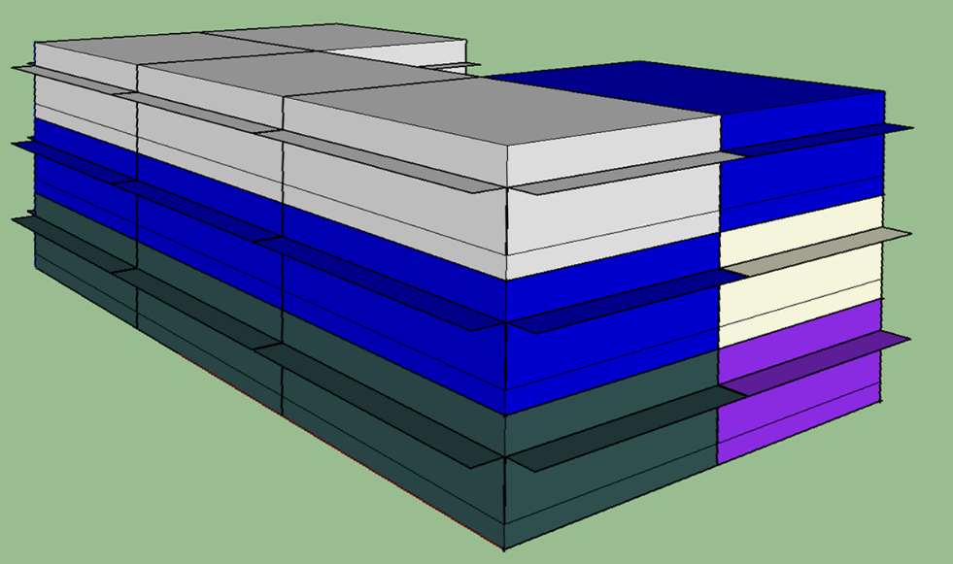
GENERAL DATA
N
NUMBER OF FLOORS: 3
FLOOR HEIGHT: 4 m
WINDOW TO WALL RATIO: 0,5
OFFSET ABOVE FLOOR: 0,75m
OVERHANGS PROJECTION FACTOR: 0,5m
TOTAL THERMAL ZONES: 6
OFFICE
7,5m
RESTROOM
PLAN
15m
OFFICE
OFFICE
OFFICE
30m
PERSPECTIVE
SCHEDULE EQUIPMENT USE
THERMAL ZONES
SCHEDULE LIGTH USE

Slide 4


Latitude: 44.92°
Longitude: 9.73°
Elevation: 134 meters above sea
Summer Design Day: 21 | Aug
Winter Design Day: 21 | Jan
Max. Temperature: 33.1° C
Min. Temperature: -6.1 °C
SITE CHARACTERISTICS
EXT. WALL
EXT. SLAB
EXT. ROOF
2
3
1_Stucco: 0,0253m
2_Concrete: 0,0253m
3_Wall Insulation: 0,0681m
4_Gypsum: 0,0127m
2
1
1
1_Concrete: 0,1016m
2_Carpet Pad: 0,10 m2K/W
(Thermal Resistance)
1_Metal Decking: 0,0015m
2_Roof Insulation: 0,2105m
3_Roof Membram: 0,0095m
CASE LOCATION 1: PIACENZA - IT
CONSTRUCTION CHARACTERISTICS
4
1
2
3
INT. WALL
INT. FLOOR | CEILING
WINDOW
3
1_Gypsum Board: 0,019m
2_Air Space: 0,15 m2K/W
3_Gypsum Board: 0,019m
2
Glass: 0,003m
1
1_Lightweight Concrete: 0,1016m
2_Ceiling air space: 0,18 m2K/W
3_Acoustic Tile: 0,0191m
1
2
3

Slide 5
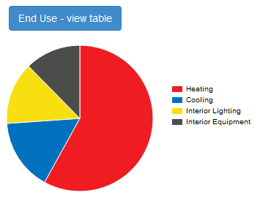
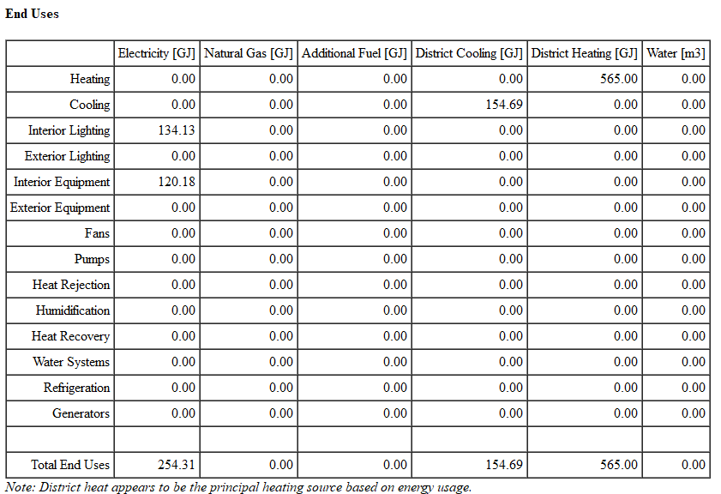
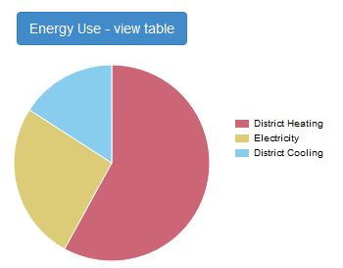
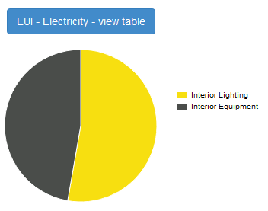
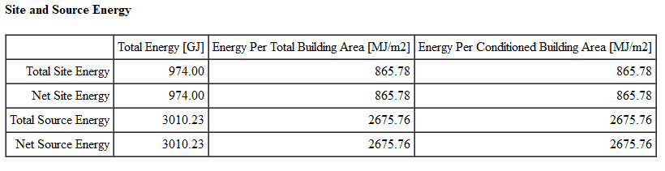
CASE LOCATION 1: PIACENZA - IT

Slide 6
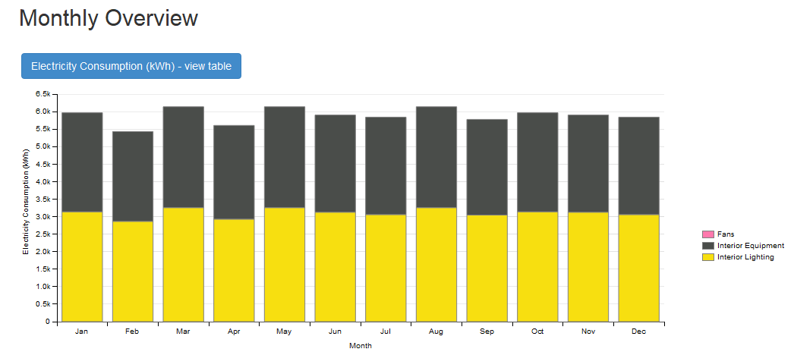
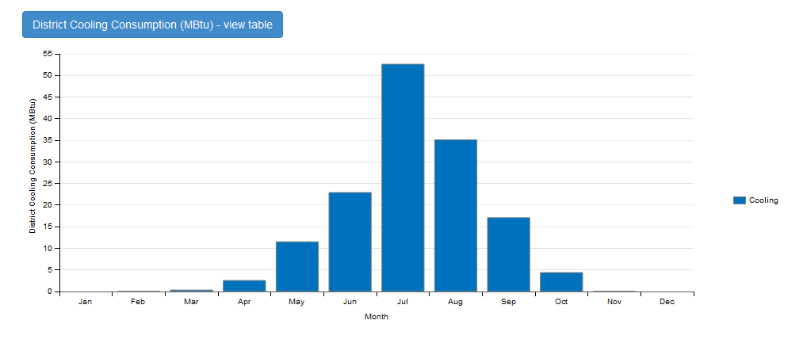
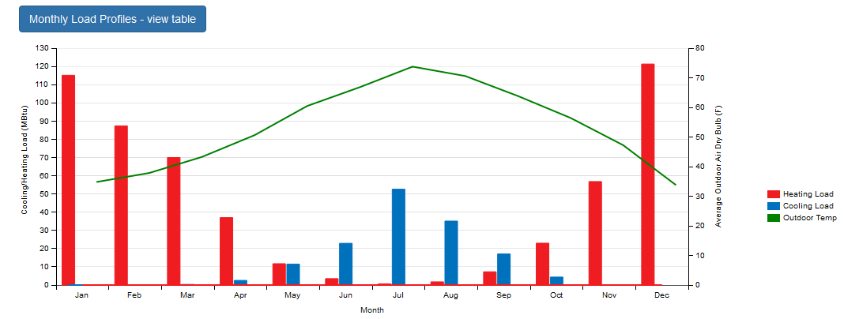
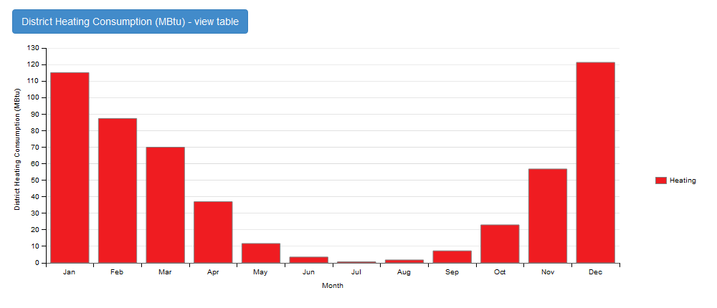
CASE LOCATION 1: PIACENZA - IT

Slide 7

Latitude: -0,15°
Longitude: -0,78°
Elevation: 2812 meters above sea
Summer Design Day: 21 | Aug
Winter Design Day: 21 | Nov
Max. Temperature: 21.9° C
Min. Temperature: 6.8 °C
SITE CHARACTERISTICS
EXT. WALL
EXT. SLAB
EXT. ROOF
2
3
1_Stucco: 0,0253m
2_Concrete: 0,0253m
3_Wall Insulation: 0,0681m
4_Gypsum: 0,0127m
2
1
1
1_Concrete: 0,1016m
2_Carpet Pad: 0,10 m2K/W
(Thermal Resistance)
1_Metal Decking: 0,0015m
2_Roof Insulation: 0,2105m
3_Roof Membram: 0,0095m
CASE LOCATION 2: QUITO - EC
CONSTRUCTION CHARACTERISTICS
4
1
2
3
INT. WALL
INT. FLOOR | CEILING
WINDOW
3
1_Gypsum Board: 0,019m
2_Air Space: 0,15 m2K/W
3_Gypsum Board: 0,019m
2
Glass: 0,003m
1
1_Lightweight Concrete: 0,1016m
2_Ceiling air space: 0,18 m2K/W
3_Acoustic Tile: 0,0191m
1
2
3

Slide 8
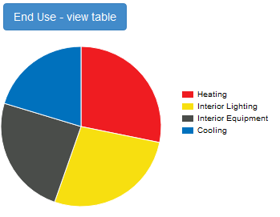
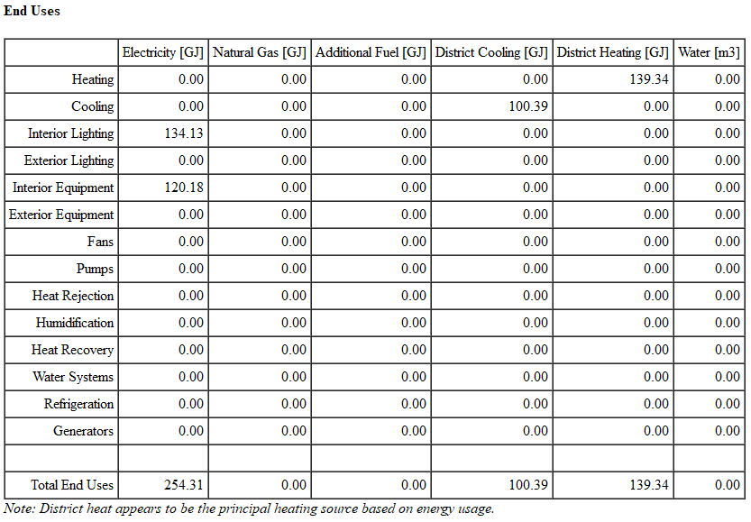
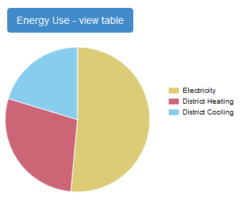
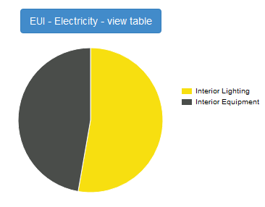
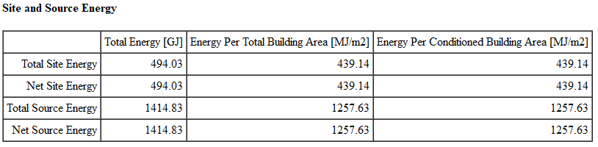
CASE LOCATION 2: QUITO - EC

Slide 9
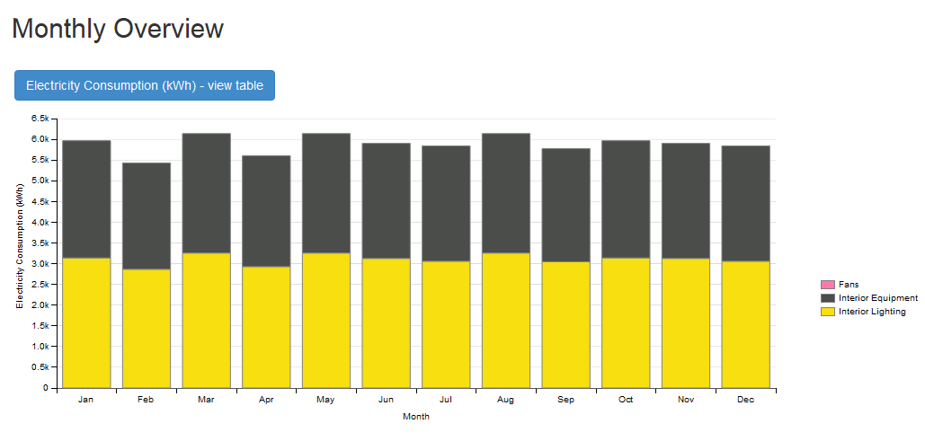
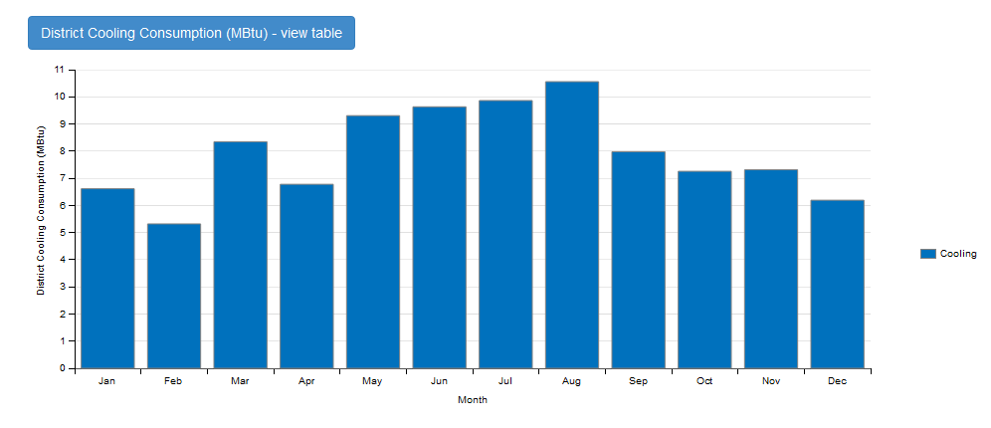
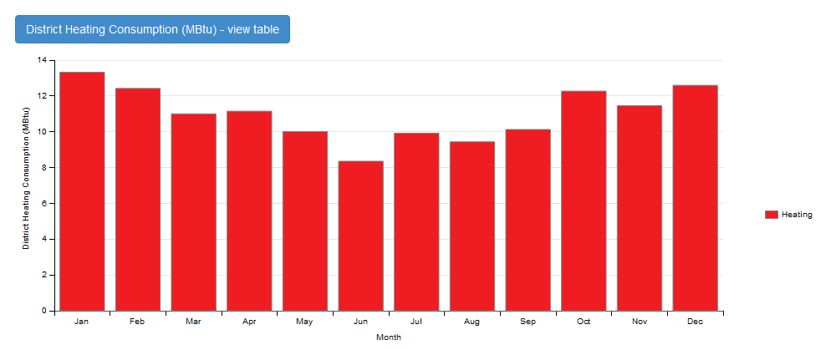
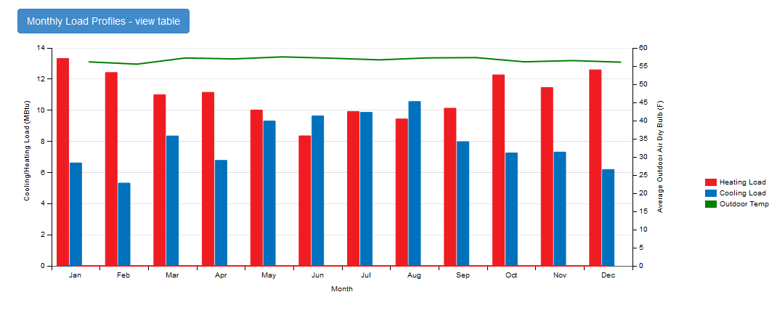
CASE LOCATION 2: QUITO - EC

Slide 10

Latitude: 59.9°
Longitude: 10.62°
Elevation: 17 meters above sea
Summer Design Day: 21 | JUL
Winter Design Day: 21 | JAN
Max. Temperature: 26.8° C
Min. Temperature: -17.0 °C
SITE CHARACTERISTICS
EXT. WALL
EXT. SLAB
EXT. ROOF
2
3
1_Stucco: 0,0253m
2_Concrete: 0,0253m
3_Wall Insulation: 0,0337m
4_Gypsum: 0,0127m
2
1
1
BAD INSULATION
1_Concrete: 0,1016m
2_Carpet Pad: 0,10 m2K/W
(Thermal Resistance)
1_Metal Decking: 0,0015m
2_Roof Insulation: 0,1693m
3_Roof Membram: 0,0095m
CASE LOCATION 3.1: OSLO - NRW
CONSTRUCTION CHARACTERISTICS
4
1
2
3
INT. WALL
INT. FLOOR | CEILING
WINDOW
3
1_Gypsum Board: 0,019m
2_Air Space: 0,15 m2K/W
3_Gypsum Board: 0,019m
2
Glass: 0,003m
1
1_Lightweight Concrete: 0,1016m
2_Ceiling air space: 0,18 m2K/W
3_Acoustic Tile: 0,0191m
1
2
3

Slide 11
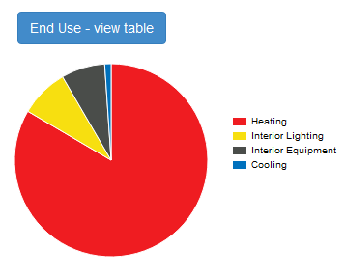
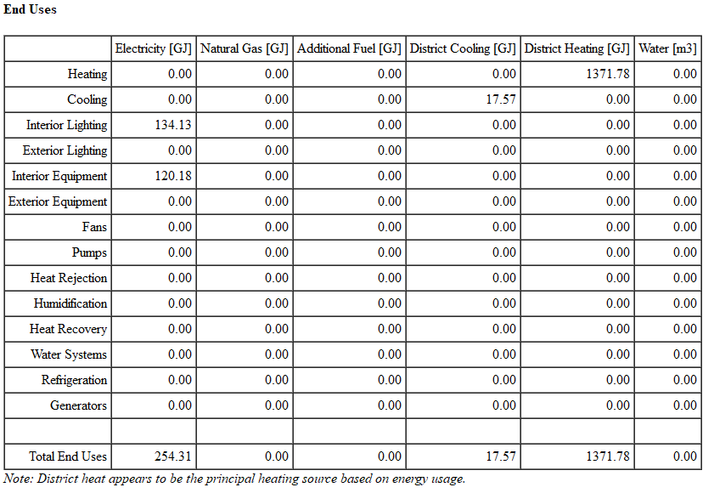
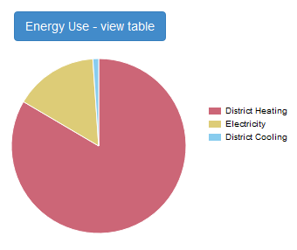
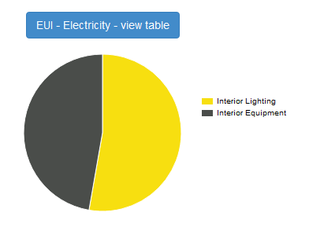

BAD INSULATION
CASE LOCATION 3.1: OSLO - NRW

Slide 12
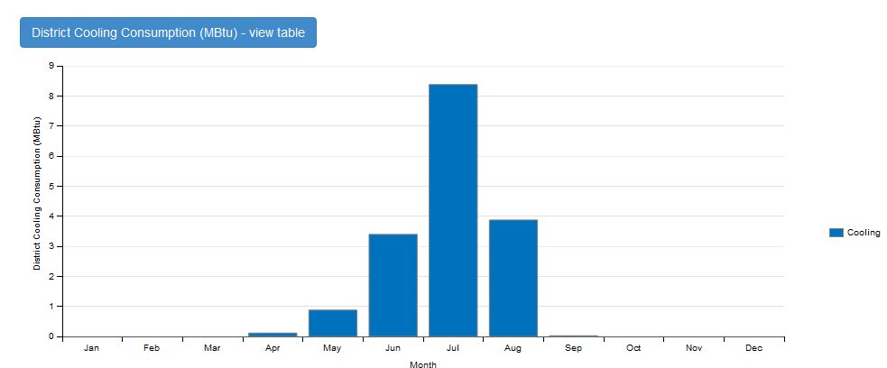
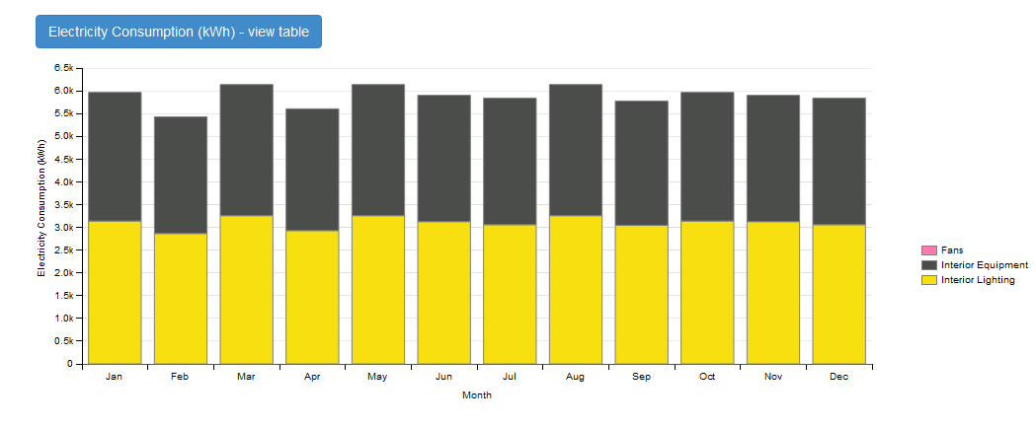
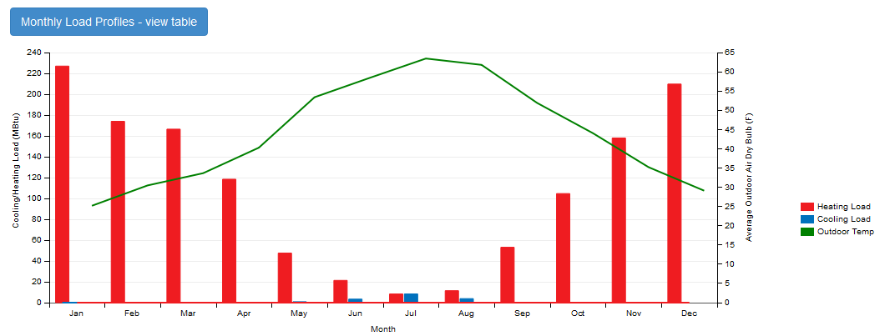
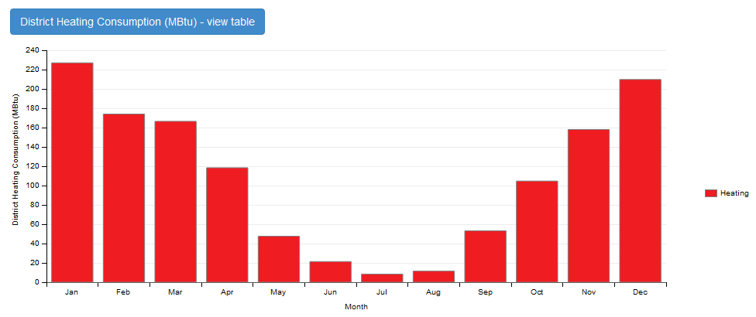
BAD INSULATION
CASE LOCATION 3.1: OSLO - NRW

Slide 13
Latitude: 59.9°
Longitude: 10.62°
Elevation: 17 meters above sea
Summer Design Day: 21 | JUL
Winter Design Day: 21 | JAN
Max. Temperature: 26.8° C
Min. Temperature: -17.0 °C
SITE CHARACTERISTICS
EXT. WALL
EXT. SLAB
EXT. ROOF
2
3
1_Stucco: 0,0253m
2_Concrete: 0,0253m
3_Wall Insulation: 0,0681m
4_Gypsum: 0,0127m
2
1
1
MEDIUM INSULATION
1_Concrete: 0,1016m
2_Carpet Pad: 0,10 m2K/W
(Thermal Resistance)
1_Metal Decking: 0,0015m
2_Roof Insulation: 0,2105m
3_Roof Membram: 0,0095m
CASE LOCATION 3.1: OSLO - NRW
CONSTRUCTION CHARACTERISTICS
4
1
2
3
INT. WALL
INT. FLOOR | CEILING
WINDOW
3
1_Gypsum Board: 0,019m
2_Air Space: 0,15 m2K/W
3_Gypsum Board: 0,019m
2
Glass: 0,003m
1
1_Lightweight Concrete: 0,1016m
2_Ceiling air space: 0,18 m2K/W
3_Acoustic Tile: 0,0191m
1
2
3

Slide 14
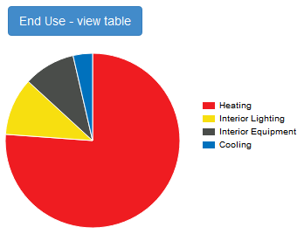
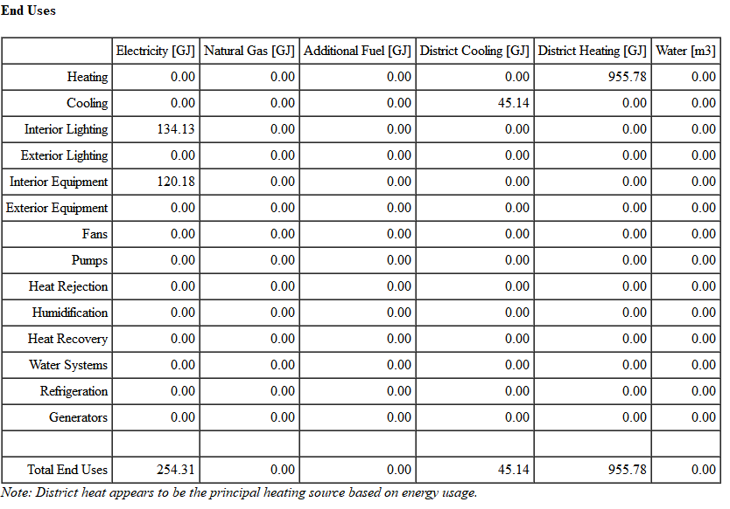
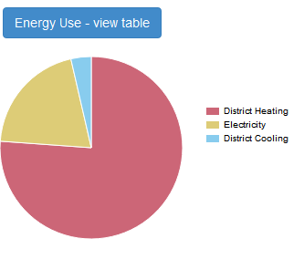
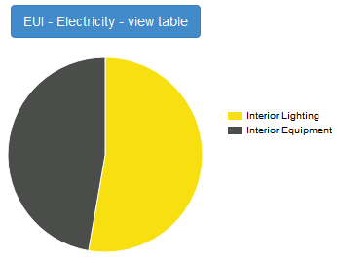
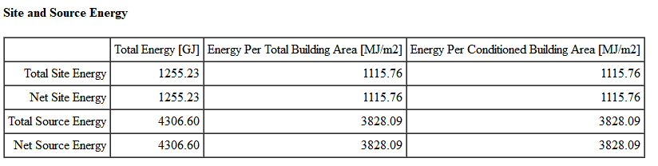
MEDIUM INSULATION
CASE LOCATION 3.1: OSLO - NRW

Slide 15
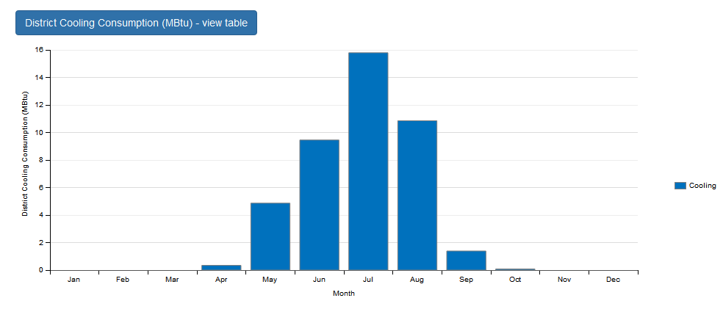
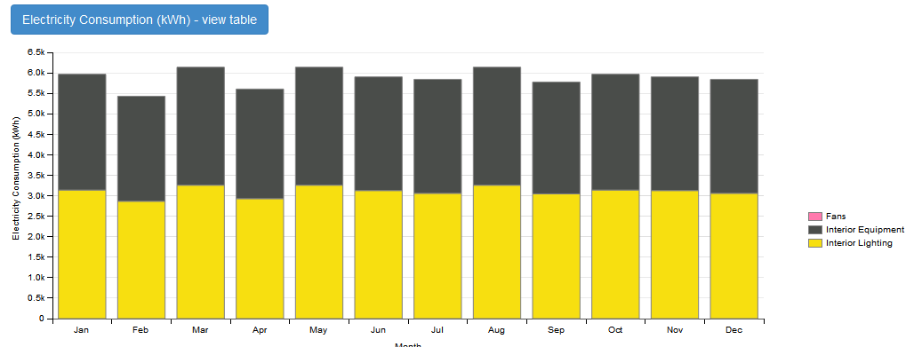
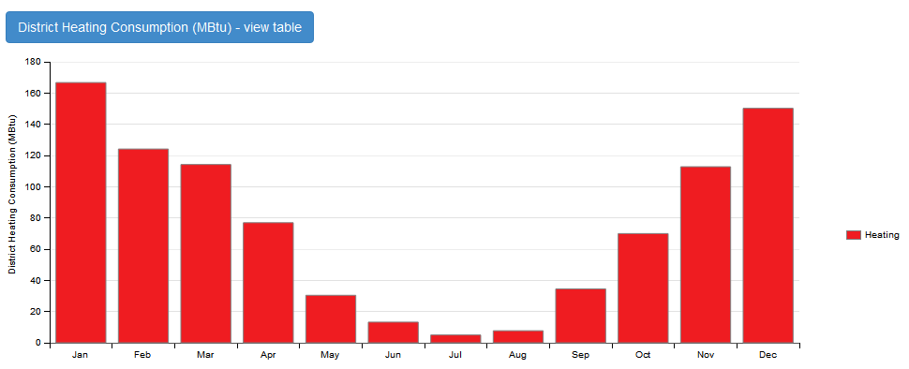
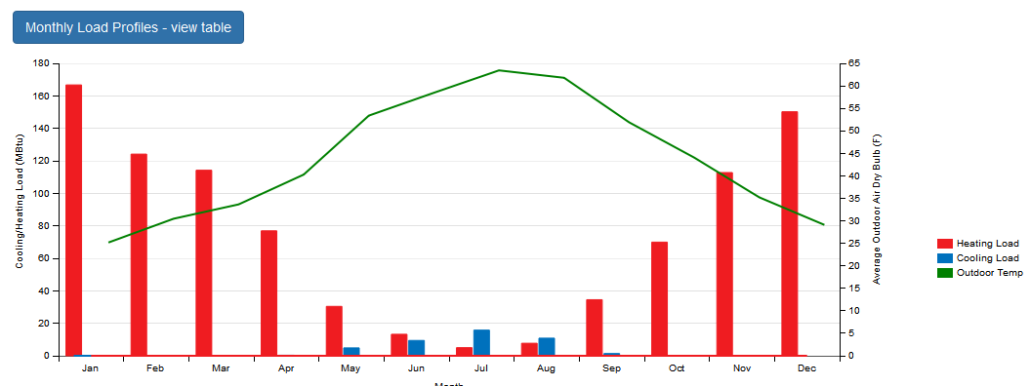
MEDIUM INSULATION
CASE LOCATION 3.1: OSLO - NRW

Slide 16
Latitude: 59.9°
Longitude: 10.62°
Elevation: 17 meters above sea
Summer Design Day: 21 | JUL
Winter Design Day: 21 | JAN
Max. Temperature: 26.8° C
Min. Temperature: -17.0 °C
SITE CHARACTERISTICS
EXT. WALL
EXT. SLAB
EXT. ROOF
2
3
1_Stucco: 0,0253m
2_Concrete: 0,0253m
3_Wall Insulation: 0,1104m
4_Gypsum: 0,0127m
2
1
1
GOOD INSULATION
1_Concrete: 0,1016m
2_Carpet Pad: 0,10 m2K/W
(Thermal Resistance)
1_Metal Decking: 0,0015m
2_Roof Insulation: 0,2941m
3_Roof Membram: 0,0095m
CASE LOCATION 3.1: OSLO - NRW
CONSTRUCTION CHARACTERISTICS
4
1
2
3
INT. WALL
INT. FLOOR | CEILING
WINDOW
3
1_Gypsum Board: 0,019m
2_Air Space: 0,15 m2K/W
3_Gypsum Board: 0,019m
2
Glass: 0,003m
1
1_Lightweight Concrete: 0,1016m
2_Ceiling air space: 0,18 m2K/W
3_Acoustic Tile: 0,0191m
1
2
3

Slide 17
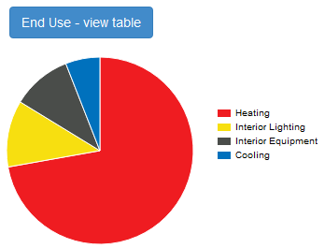

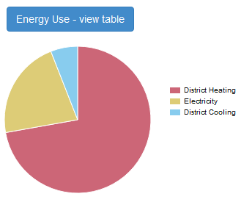
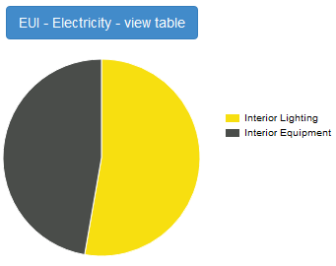
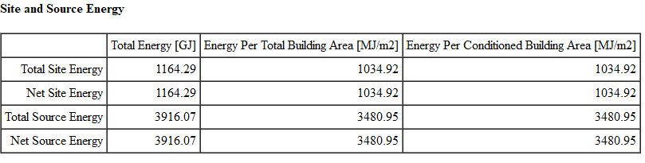
GOOD INSULATION
CASE LOCATION 3.1: OSLO - NRW

Slide 18
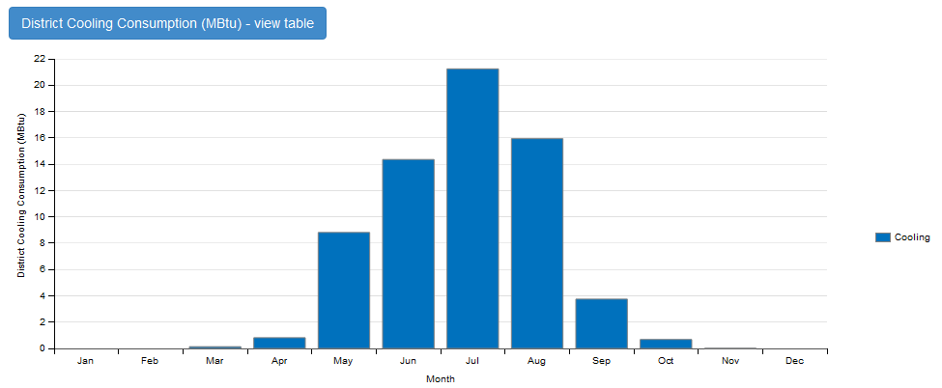
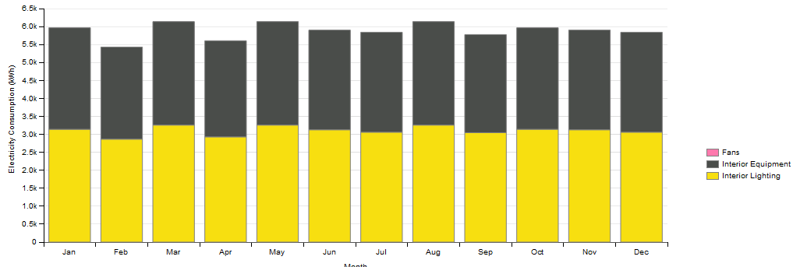
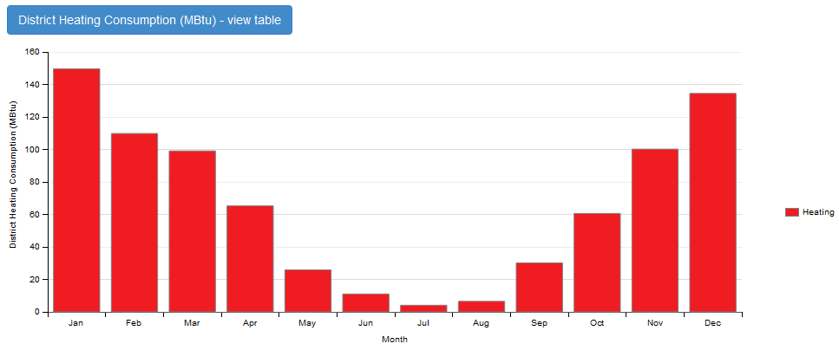
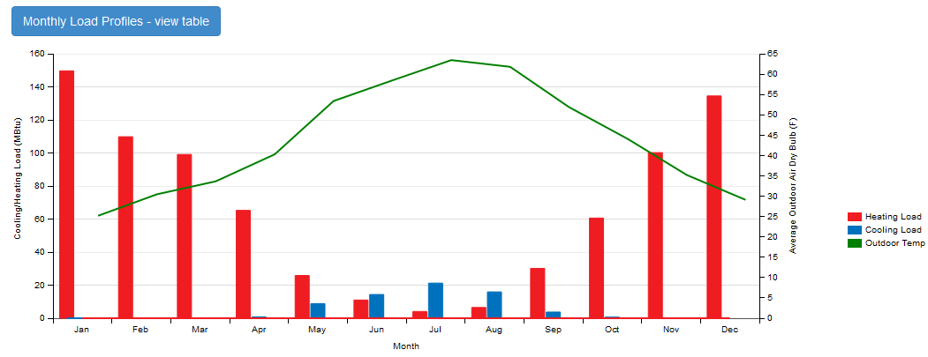
GOOD INSULATION
CASE LOCATION 3.1: OSLO - NRW

Slide 19
CONCLUSIONS
At the moment we compare the results obtained through the Open Studio software with the yearly energy consumption in each different city, with the same building and the same type of insulation, we can conclude important assumptions:
The city location plays the most important factor in order to determine the energy consumption, for this reason the city of Quito, the closest one to the Equatorial line is the place with less energy consumption. While on the other side Oslo, the farest city from the Equatorial line, hence the coldest city, is the one that consumes more energy throughout the year.
For the case of the city of Quito the software calculates the heating and cooling consumption; nevertheless, in this city it is not necessary the use of this kind of systems because the average temperature maintains constant during the whole year, and for this situation it is possible to obtain the desired inner temperature with the application of a proper insulation and the use of proper external insulation panels to keep the heat out.
When we compare the city with the lowest temperatures applying different insulations in the walls and roof, from a bad insulation to a medium and a good one, we can observe a difference of 479,36 GJ between the good and the bad case. However, we also observe when we increase the insulation it is true that the yearly heating consumption reduces, but the cooling consumption increases; this could happen because of course during summer months, the places with higher insulation will need more cooling energy to reach the desired inner temperature.
It is important to take into account the results obtained with the software are not a 100% real, because the model applied is just a simplified representation of a real building, and it does not consider the whole complexity implied in true life. Nonetheless, this exercise helps to understand the differences between different location and different types of insulation and how these affects the energy consumption.
GJ
GJ

